Slide 1

Drinking Water in Alaska:
SDWA, PWS permits, well permits
40 CFR 141+, 18 AAC 80
(NOT CWA 401, 404, NPDES/APDES, water rights, temporary water use, or saltwater)
ENVE 644
Mel Durrett
Feb 26, 2020
Photo: blueosa.com

Slide 2
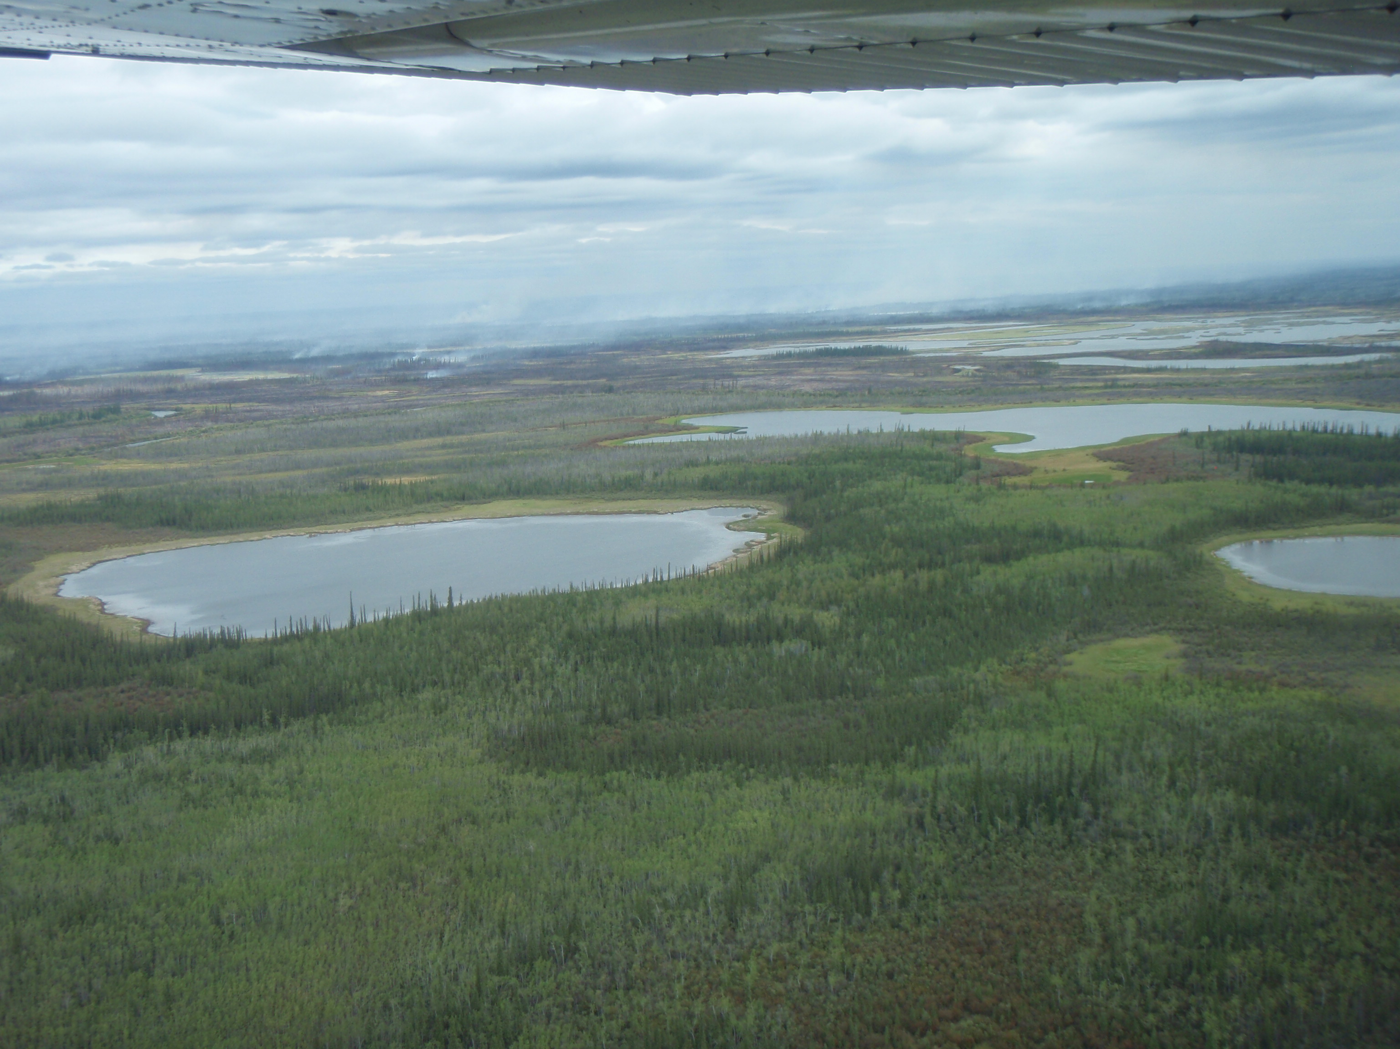
Alaska is #1 for water
>40% of the nation’s surface water resources
  3 million+ lakes
  12,000+ rivers
~44% of Alaska’s land area classified as wetlands
33,000+ miles of coastline (more than the rest of the country added together)
Largest volume of groundwater in the U.S.
  Permafrost is a challenge to extraction
  Recharge in spring mainly due to snowmelt
  Steep topography can limit aquifer size

Slide 3
Federal water statutes & regs
Clean Water Act (surface water)
  401 pollution
  404 wetlands
Safe Drinking Water Act (groundwater)
Ocean Dumping Act (marine)

Slide 4
Safe Drinking Water Act (1974)
Title XIV of The Public Health Service Act: Safety of Public Water Systems
  Goal to protect public health by regulating the nation’s drinking water supply
  Amended in 1986, 1996
Applies to drinking water and its sources, e.g., rivers, lakes, reservoirs, springs, groundwater wells
  Does NOT regulate private drinking water wells serving <25 individuals
Authorizes EPA to set health-based standards for maximum contaminant loads in drinking water (both natural and man-made, like disinfectants)
EPA cedes primacy to some states and tribes → ADEC
Notes:
Less an “environmental” law than a “public health” law
In fact, all states and territories EXCEPT Wyoming and D.C. have primacy
Four tribes have gained primacy “treated as a state” although none have gained primacy directly as of

Slide 5
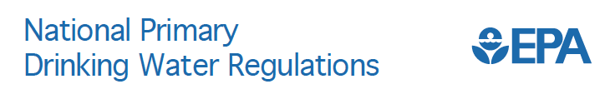
40 CFR 141, 40 CFR 142 (implementation)
Legal limits on >90 contaminants
Water-testing schedules
Methods that public water systems must follow (analysis and treatment)
Download the whole table here:https://www.epa.gov/ground-water-and-drinking-water/national-primary-drinking-water-regulation-table

Slide 6
• Maximum Contaminant Level Goal (MCLG): The level of a contaminant in drinking water below which there is no known or expected risk to health. MCLGs allow for a margin of safety and are non-enforceable public health goals.
• Maximum Contaminant Level (MCL): The highest level of a contaminant that is allowed in drinking water. MCLs are set as close to MCLGs as feasible using the best available treatment technology and taking cost into consideration. MCLs are enforceable standards.
• Maximum Residual Disinfectant Level Goal (MRDLG): The level of a drinking water disinfectant below which there is no known or expected risk to health. MRDLGs do not reflect the benefits of the use of disinfectants to control microbial contaminants.
• Maximum Residual Disinfectant Level (MRDL): The highest level of a disinfectant allowed in drinking water. There is convincing evidence that addition of a disinfectant is necessary for control of microbial contaminants.
• Treatment Technique (TT): A required process intended to reduce the level of a contaminant in drinking water.
Notes:
MCLs and MRDLs are enforceable; GOALS are not. Treatment techniques are required for particular contaminants.

Slide 7
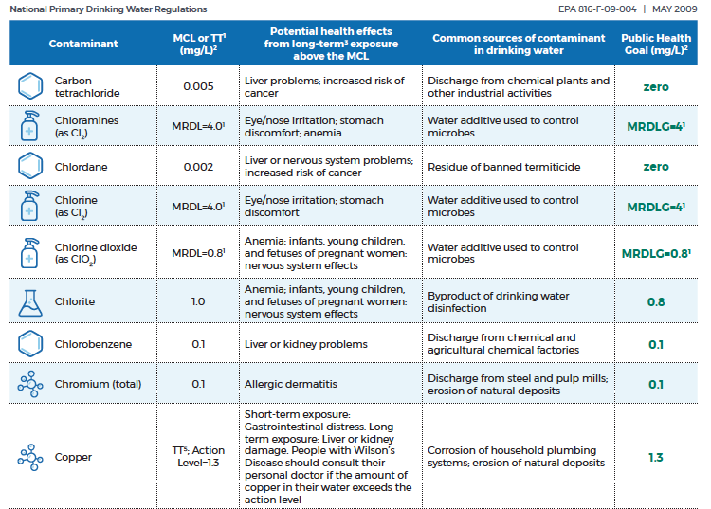
Etc.
Notes:
Download the whole table here:https://www.epa.gov/ground-water-and-drinking-water/national-primary-drinking-water-regulation-table

Slide 8
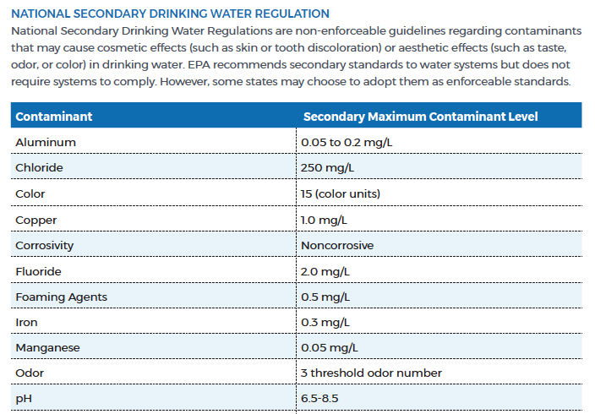
40 CFR 143. Non-enforceable;
states may adopt as enforceable stds
Etc.

Slide 9
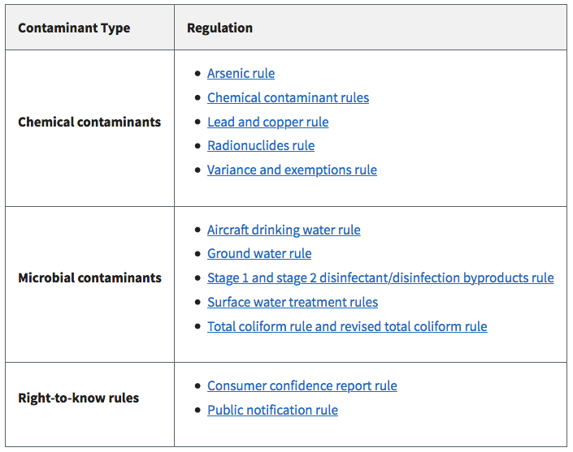
Notes:
There are RULES for specific contaminants, in specific situations.

Slide 10
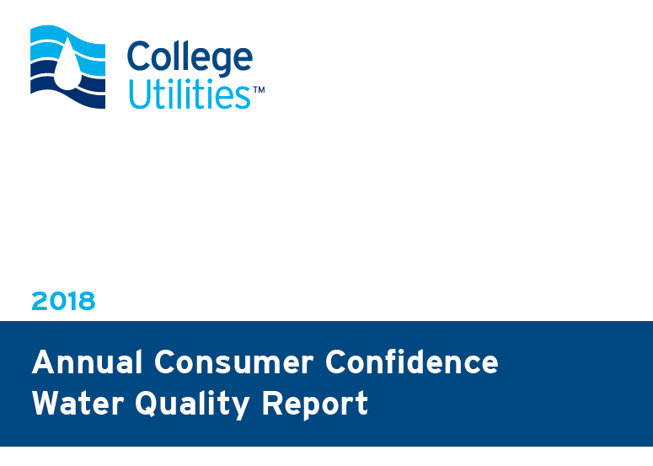
Publicly available
Consumer Confidence Reports (CCR)
are required under SDWA
Notes:
You can search for these via the EPA website, but they aren’t always posted there. Your better bet is to do an online search for your water utility.

Slide 11
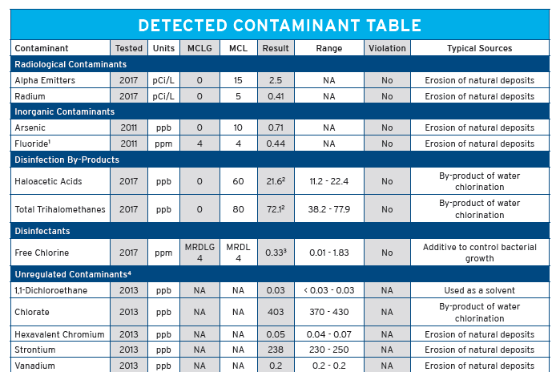
Etc.

Slide 12
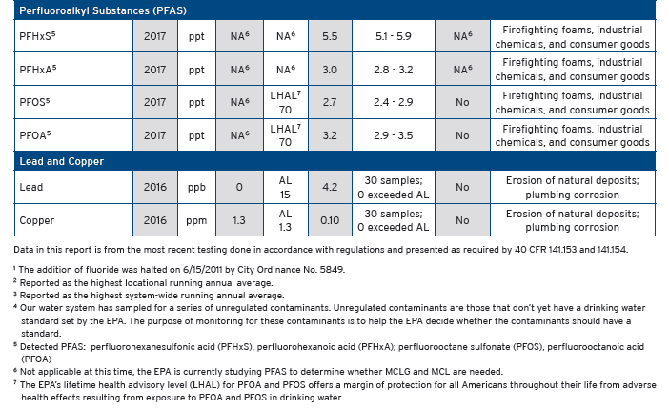
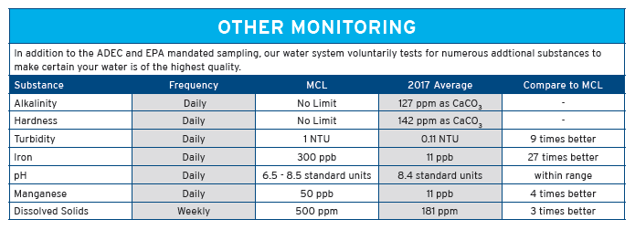

Slide 13
Proof that a Public Water System provided a CCR
(sent to DEC)

Slide 14
Alaska DEC Drinking Water program
18 AAC 80
Requires owners/operators of public water systems (PWS) monitor for contaminants
  Reviews the results
  Statewide database on monitoring, compliance, enforcement of PWS (https://dec.alaska.gov/DWW/index.jsp)
Permits design/construction/operation for Alaska’s ~1600 PWS’s
Provides info and guidance to the public, PWS owners/operators/consumers
Responds to complaints about contamination/damage in public wells/watersheds
Drinking Water Source Protection group
  Formerly provided PWS Source Assessments
  Endorses Drinking Water Source Protection plans (makes communities eligible for funding)

Slide 15
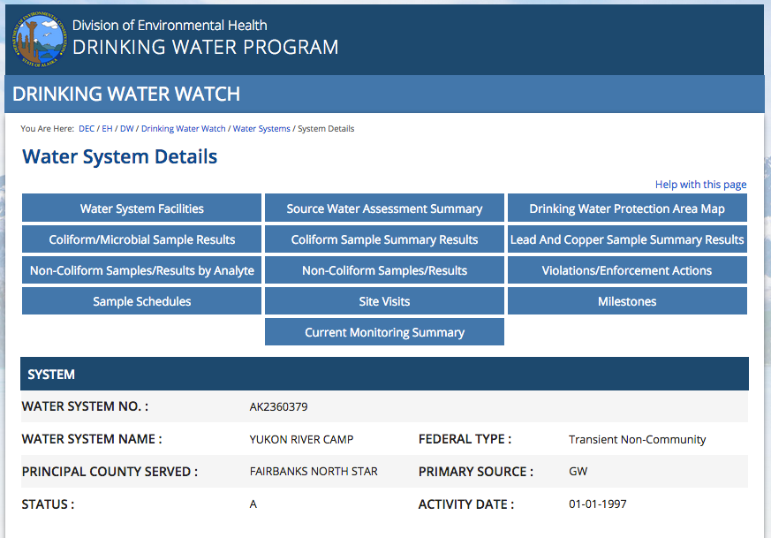
https://dec.alaska.gov/DWW/index.jsp

Slide 16
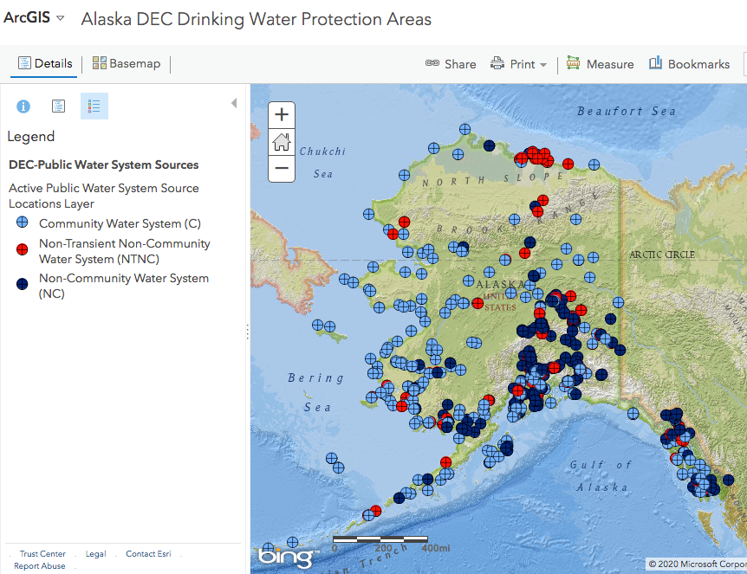
http://www.arcgis.com/home/webmap/viewer.html?webmap=13ed2116e4094f9994775af9a62a1e85

Slide 17
Public Water Systems (PWS)
Classifications
Community Water System (CWS)
  expects to serve, year round, at least 25 individuals;
  or expects to serve, year round, at least 15 residential service connections
Non-Transient Non Community Water System (NTNCWS)
  regularly serves the same 25 or more individuals for at least 6 months of the year
Transient Non Community Water System (TNCWS)
  is not a CWS or NTNCWS
  regularly serves at least 25 individuals each day for at least 60 days of the year
Notes:
There’s a whole field guide giving WAY more detail on how to categorize your PWS, and you have to study it to become a certified PWS operator.

Slide 18
PWS Permits:
Construction/Operations
Permits required for new construction/modifications/improvements/waivers
  So. Many. Checklists.
Step 1. DEC Engineering Plan Review
  Plan sets must be complete (checklists!)
  Due 30 days before work starts
  Due 60 days “ “ “ if state/federal $ involved
  Approval to Construct issued (or denied) within 30 days of receiving all needed info
    Valid for 2 years – after that, apply for extension (more fees)
FORMS: https://dec.alaska.gov/eh/dw/engineering/plan-review-checklist/
Notes:
https://dec.alaska.gov/eh/dw/engineering/plan-review-checklist/

Slide 19
PWS Permits:
Construction/Operations
Step 2. Approval to Operate
  Interim Approval to Operate can be granted before all post-construction forms are submitted
    Request letter
    Verification that construction substantially complete
    Documentation that construction conditions were met
    Results of required tests, e.g., pressure, bacteriological
  Final Approval to Operate
    All of the above, plus…
    Third party Sanitary Survey
    Emergency Preparedness Compliance Certification
    Justification for any plan changes that were made
    Complete set of plans as-built
FORMS: https://dec.alaska.gov/eh/dw/engineering/plan-review-checklist/
Notes:
https://dec.alaska.gov/eh/dw/engineering/plan-review-checklist/

Slide 20
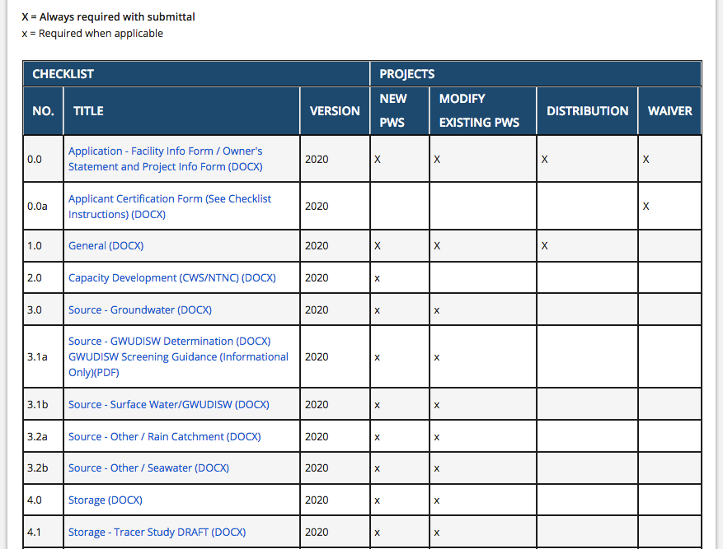
PWS Checklists

Slide 21
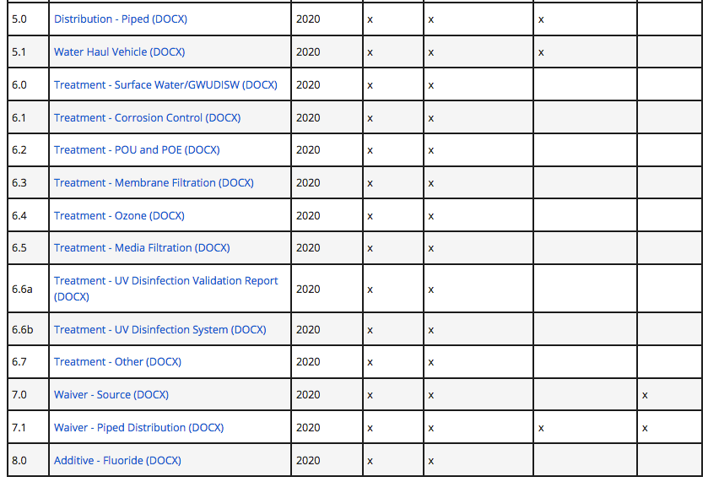
PWS Checklists

Slide 22
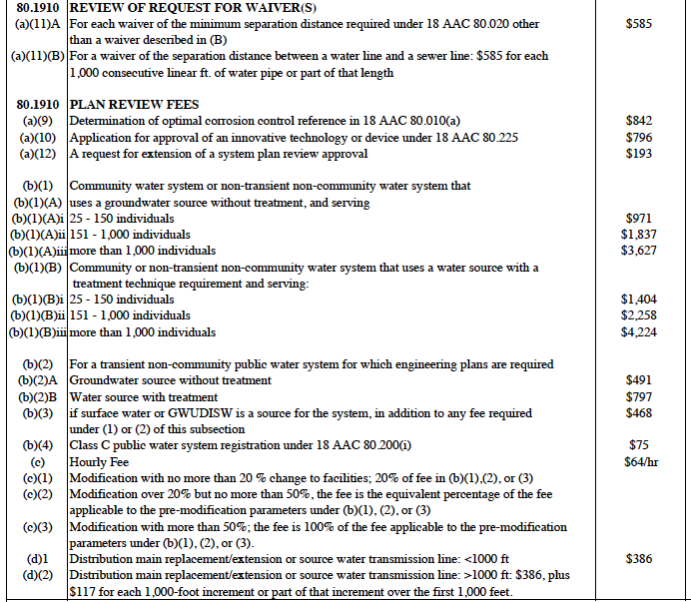

Slide 23
Q. Do I need to submit for approval to construct for an emergency repair or routine maintenance?
Written approval is not required for an emergency repair or routine maintenance of a public water system; however, emergency repair is not defined in regulation. It is advised to contact your local DEC engineer regarding your situation. If modifications are made to the system as the result of an emergency situation, please contact us as soon as possible to let us know so that we can be prepared if we get calls from the public. Routine maintenance is defined in 18 AAC 80.1990 (a)(123) as activity normally required to maintain the components of a public water system in good working order; it includes the replacement of a pump, 40 feet or less of pipe, a valve, valve coating, or a hydro-pneumatic tank, or a storage tank. Routine maintenance does not include changes that affect the system's configuration, material, treatment, or capacity. Once the emergency is passed or the routine maintenance is completed, we request that documentation of any changes to the system be submitted for the system’s file.
https://dec.alaska.gov/eh/dw/engineering/#nogo

Slide 24
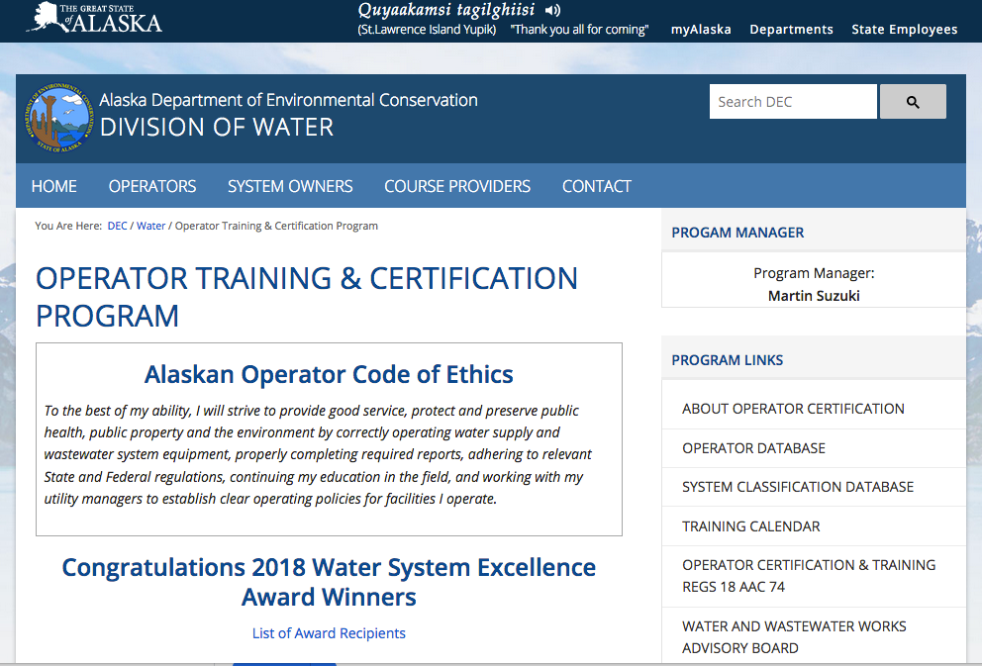
Public Water Systems (PWS)

Slide 25
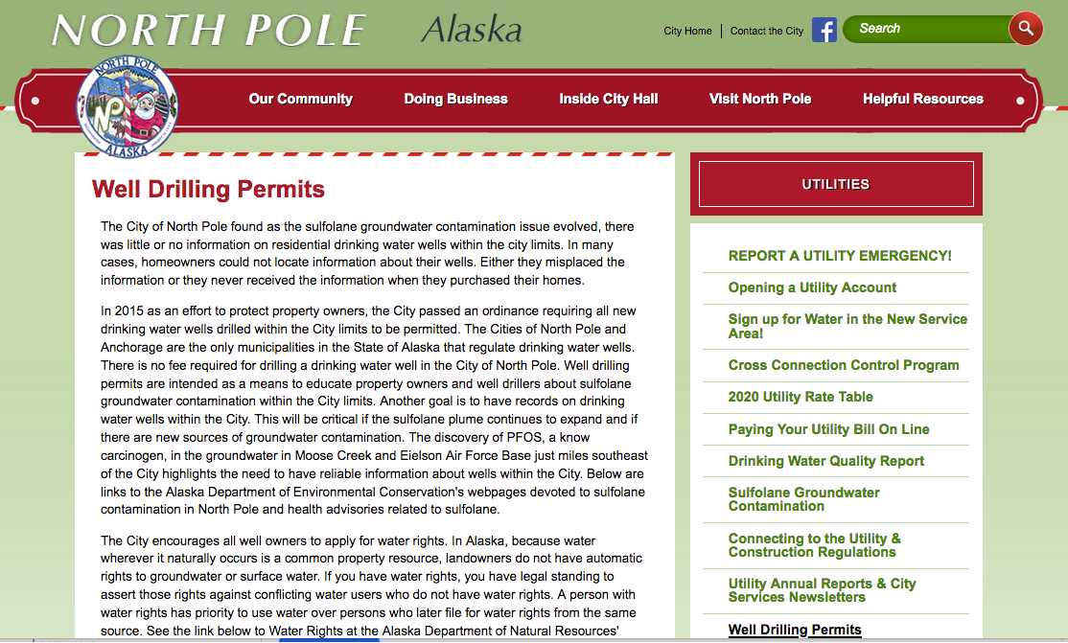
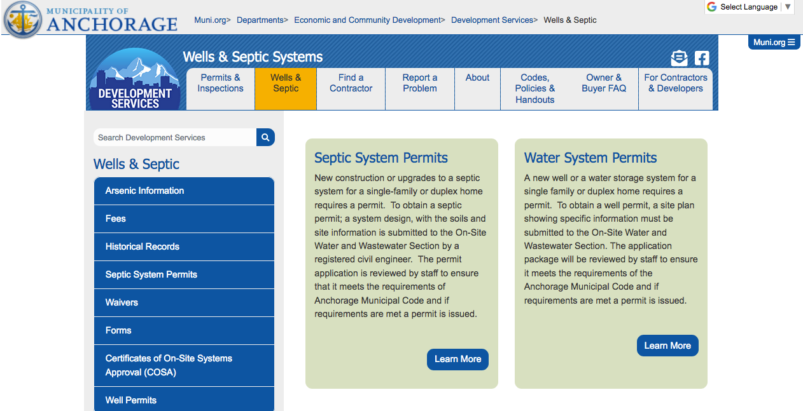
Private Wells
Only 2 places in Alaska require permits for a private well or water system

Slide 26
Private Wells
Not regulated under SDWA
DEC requires minimum separation distances from local sources of contamination, i.e. septic
  But it’s only enforced when a septic system is installed by a certified installer. Some DIY their septics.
  So you might not know you’re out of compliance until you try to sell your home.
Well contractors must submit data on completed wells to a tracking database (Well Log Tracking System (WELTS) )
  Homeowners should ensure this gets done, because if it doesn’t, you may have trouble selling your home in the future.
  Also submit for when decommissioning a well

Slide 27
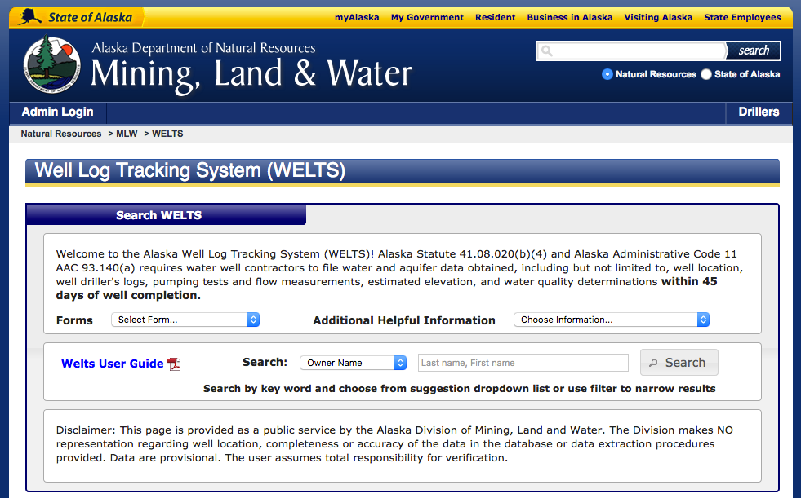
Well Log Tracking System (WELTS) – database of well info populated by water well contractors; must submit data within 45 days of well completion.
Notes:
From DEC website…
Upon completing the well construction, it's in your best interest, as a homeowner, to assure that the water well drilling log is submitted to the Department of Natural Resources (DNR) in order to record the information in WELTS. While water well contractors are required to submit this information to DNR, it is not always carried out. Failure to record this information in WELTS may lead to difficulties in future real estate transactions. Water Well Logs can be sent to DNR at: dnr.water.reports@alaska.gov or Alaska DNR, MLW, Alaska Hydrologic Survey 550 West 7th Ave, Suite 1020 Anchorage, AK 99501

Slide 28
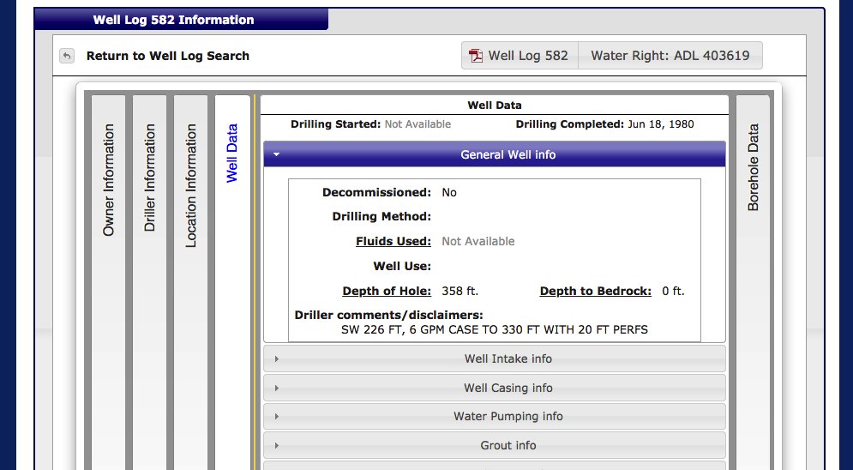
Well Log Tracking System (WELTS) – includes useful info for surrounding landowners!

Slide 29
Penalty = (A x B x C x $10) + D
18 AAC 80.1220
A=
  1 pt. - minor impacts on public health, e.g., failure to produce a CCR or meet a secondary MCL
  2 pts. - prevent the DEC’s assessment of public safety, e.g., failing to report things
  3 pts. - could prevent the PWS from supplying water to the public
  4 pts. - a specific, known health concern, e.g., failing to monitor for coliform
  5 pts. – unapproved or deficient PWS, e.g., failing to correct previous deficiencies, un-certified operator
  6 pts. – immediate threat to public health, e.g., failure to meet specific MCLs
B=
  7 pts. if previous violations within last 5 years worth 4-6 pts. above
  3 pts. if previous violations within last 5 years worth 1-3 pts. above
  1 pt. if no previous violations within last 5 years
C= 1-6 pts. depending on PWS class - how many connections does it serve?
D= (economic savings + department's reasonable costs) * number of days of violation
  Allows DEC to adjust the fine based on the size of the impact on the public, how fast the violation was fixed, how much of the problem was under the PWS’s control, etc.

Slide 30
Recap
SDWA implemented by ADEC
  MCLs/MRDLs for >90 contaminants
  CCR/WQ reports
Permits for PWS construction
  Step 1. Approval to Construct
  Step 2. Approval to Operate (interim available)
Private wells don’t need a permit (usually) but do need to be reported to WELTS database
Databases for drinking water, PWS info & wells online

Slide 31
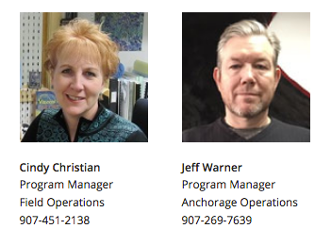
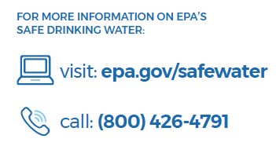
Contacts
ADEC Drinking Water program: 907-269-7656 or
1-866-956-7656 (if you are calling outside of Anchorage).
For after-hours and emergency calls, please dial 907- 451-2138.
Notes:
https://dec.alaska.gov/eh/dw/contact#nogo has a bunch of numbers for regional offices and engineers

